Slide 1


Slide 2

Deep Learning with TF
Goal
Introduce the artificial neural network and deep learning technologies
Implement them in Python with the TensorFlow framework
Syllabus
Lec01. Linear Regression (01/03)
Lec02. Logistic Regression (01/10) Hangout
Lec03. Artificial Neural Network (01/21)
Lec04. Deep Learning (01/31)
Notes:
새해 인사.
3~4장 공부. 순서가 어렵게 기술되어 있음.
기존에 있는 자료 + 책의 내용으로 강의 재구성

Slide 3
Artificial Neural Network
Yong Y. Lee
Jan 21, 2019

Slide 4
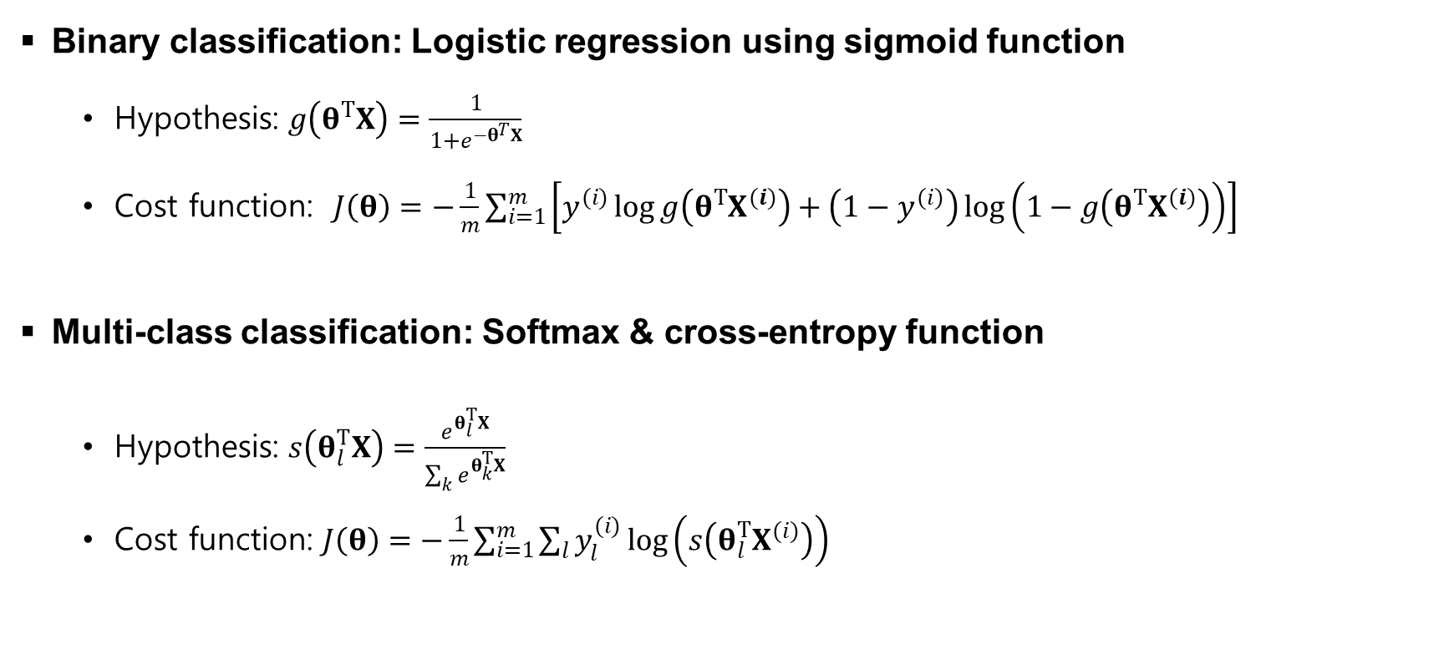
Recap
Binary classification: Logistic regression using sigmoid function
Hypothesis: $g\left(θ^{T}X\right)=\frac{1}{1+e^{−θ^{T}X}}$
Cost function: $J\left(θ\right)=−\frac{1}{m}\sum_{i=1}^{m}{\left[y^{(i)}\log{g\left(θ^{T}X^{(i)}\right)}+\left(1−y^{(i)}\right)\log\left(1−g\left(θ^{T}X^{(i)}\right)\right)\right]}$
Multi-class classification: Softmax & cross-entropy function
Hypothesis: $s\left(θ_{l}^{T}X\right)=\frac{e^{θ_{l}^{T}X}}{\sum_{k}{e^{θ_{k}^{T}X}}}$
Cost function: $J\left(θ\right)=−\frac{1}{m}\sum_{i=1}^{m}{\sum_{l}{y_{l}^{(i)}}\log\left(s\left(θ_{l}^{T}X^{(i)}\right)\right)}$
Notes:
Hypothesis: 주어진 데이터를 잘 표현할 수 있는 수학적 모델을 제안
Cost function: 제안한 모델이 parameter theta에서 주어진 데이터에 얼마나 잘 표현하고 있는지를 정략적으로 나타내는 함수 (작을 수록 잘 나타냄)
Gradient descent: Cost function을 최소화하는, 즉 주어진 데이터를 가장 잘 표현하는 모델을 만들기 위한 theta를 자동으로 추정하는 방법

Slide 5
Neural Network

Slide 6
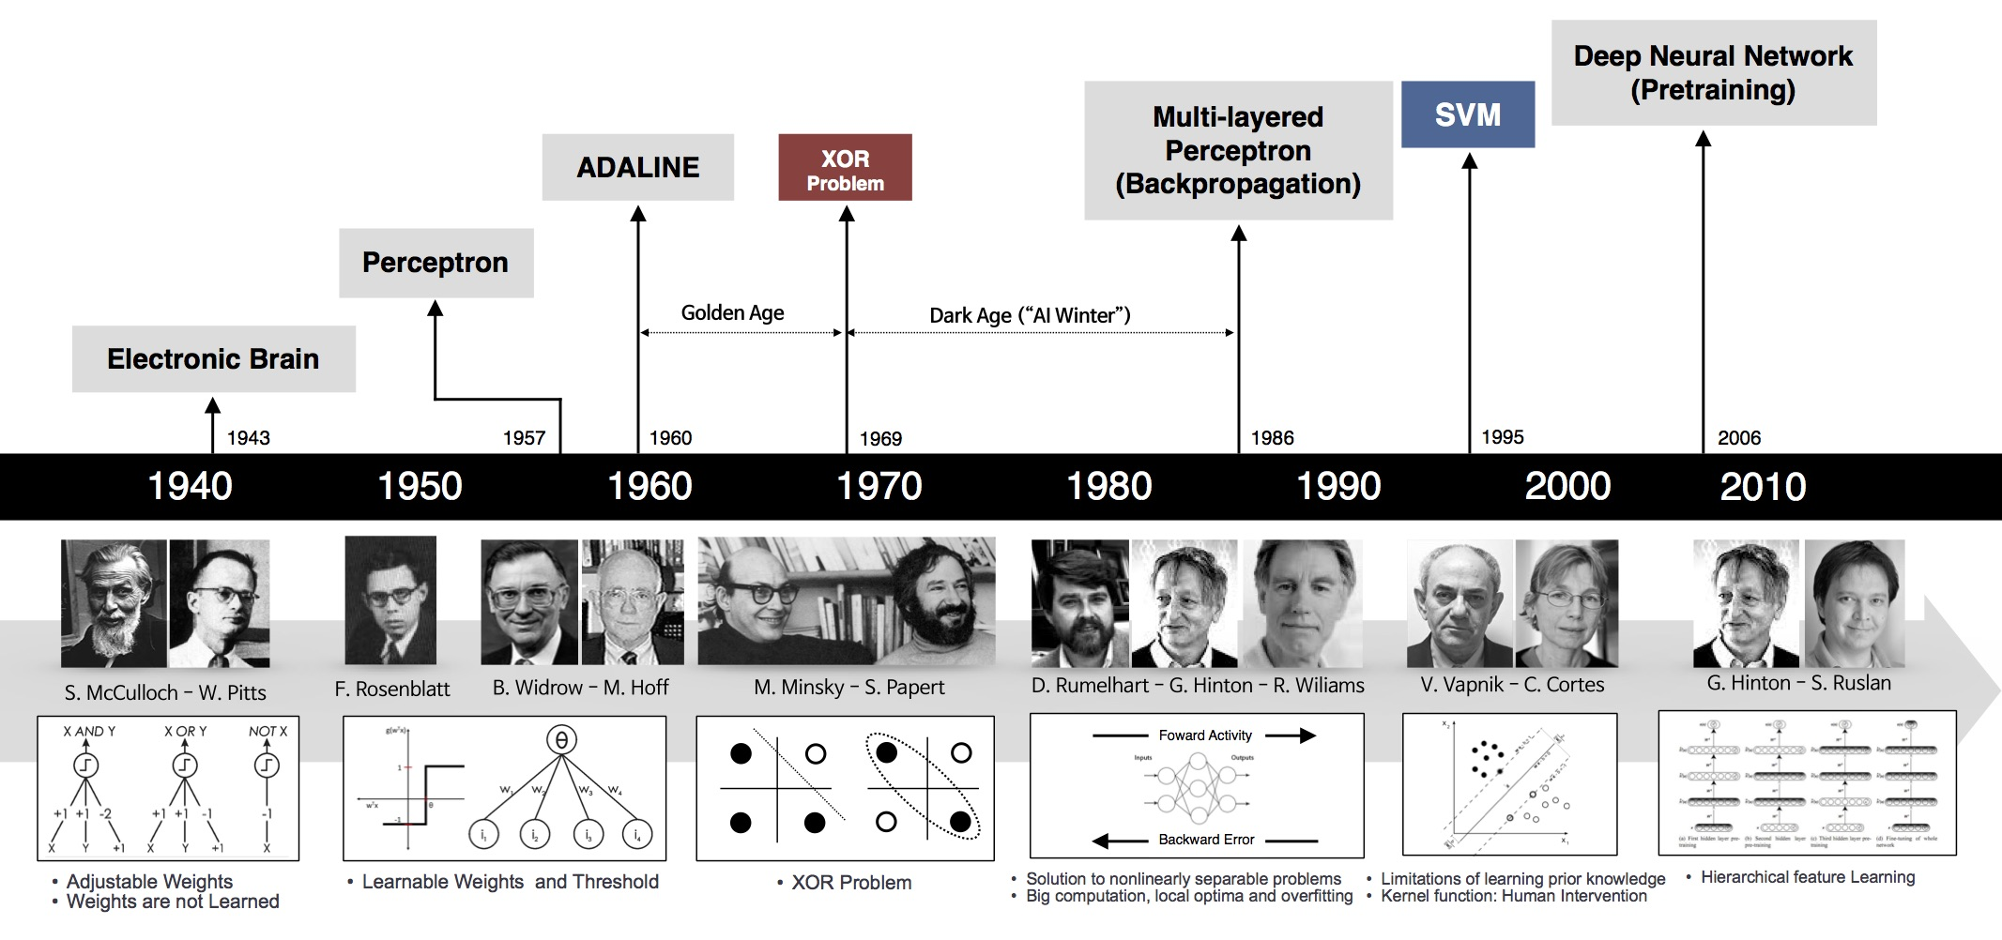
History of Neural Network
Deep Learning Part I (1957~1986)
Artificial neuron: ‘perceptron’
Neural network: ‘multi-layered perceptron’
Forward & Backward propagation
© Deep Learning 101, Andrew L. Beam

Slide 7
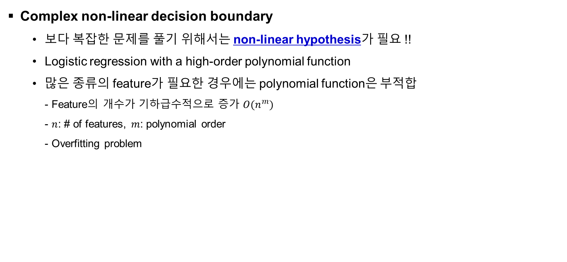
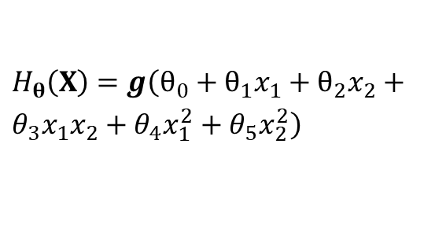


Non-linear Classification
Complex non-linear decision boundary
보다 복잡한 문제를 풀기 위해서는 non-linear hypothesis가 필요 !!
Logistic regression with a high-order polynomial function
많은 종류의 feature가 필요한 경우에는 polynomial function은 부적합 - Feature의 개수가 기하급수적으로 증가 $O(n^{m})$ - $n$: # of features, $m$: polynomial order - Overfitting problem
$$x_{2}$$
$H_{θ}\left(X\right)=g\left(θ_{0}+θ_{1}x_{1}+θ_{2}x_{2}+θ_{3}x_{1}x_{2}+θ_{4}x_{1}^{2}+θ_{5}x_{2}^{2}\right)$
Non-linear decision boundary
$$x_{1}$$
Notes:
집값 예측, 영상 처리
n: # feature, m: polynomial order

Slide 8
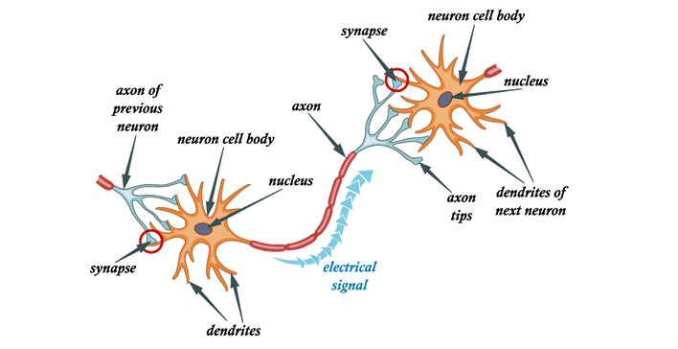
Concept of Neural Network
Mimicking the human brain (100 billion neurons)
Notes:
인간의 뇌 = 약 1000억 개의 뉴런
덴드라이트(dendrites)를 통해 신호가 들어오는데,
이 신호들이 cell에서 합쳐지는데,
이 신호의 총 크기가 일정 값이 넘으면 활성화가 되어서
Axon을 통해 다음 뉴런으로 전달됨.

Slide 9



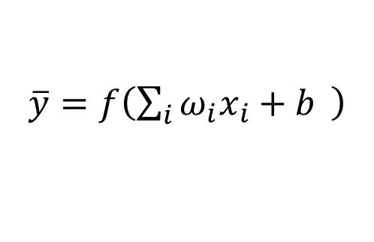

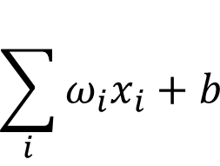


Artificial Neuron
Artificial neuron model: Logistic unit
$$x_{1}$$
$$ω_{1}$$
Synapse
Axon of prev. neuron
$$ω_{1}x_{1}$$
Neuron cell body
Dendrite
$$ω_{2}x_{2}$$
$$\sum_{i}{ω_{i}x_{i}+b}$$
$\overline{y}=f\left(\sum_{i}{ω_{i}x_{i}+b} \right)$
$$f$$
Output axon
Activation function
$$ω_{3}x_{3}$$
© Fei-Fei Li
Notes:
인간의 뇌 = 약 1000억 개의 뉴런
덴드라이트(dendrites)를 통해 신호가 들어오는데,
이 신호들이 cell에서 합쳐지는데,
이 신호의 총 크기가 일정 값이 넘으면 활성화가 되어서
Axon을 통해 다음 뉴런으로 전달됨.

Slide 10
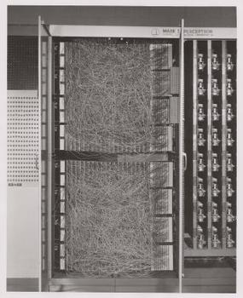
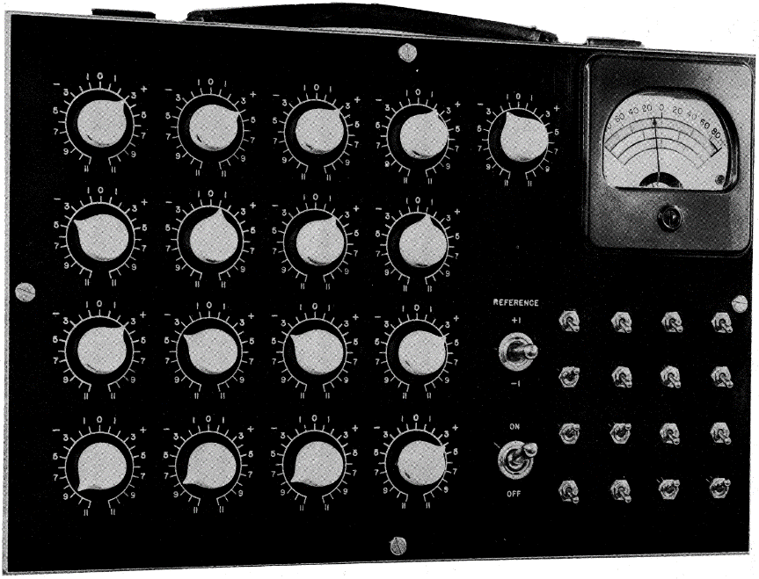
Artificial Neuron (cont’d)
Early artificial neuron: hardware implementation
Frank Rosenblatt, The Perceptron (1957)
Widrow and Hoff, Adaline/Madaline (1960)
Notes:
기울기 하강을 통해 원하는 형태로 가중치를 조절할 수 있는 최초의 신경망 모델
다이얼을 이용해 각각의 weight (parameter)를 조절

Slide 11

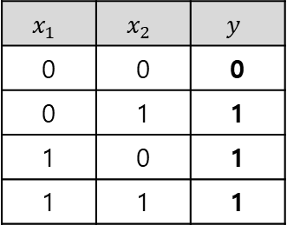

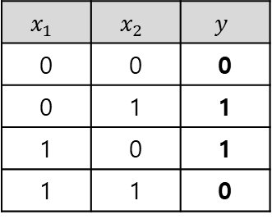
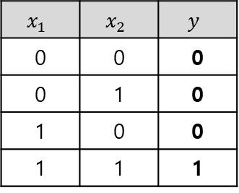





Artificial Neuron (cont’d)
AND, OR, XOR problem
CAN
CAN
CAN’T
AN
OR
AND
XOR
$$x_{1}$$
$$ω_{1}$$
$$y$$
$$x_{2}$$
$$x_{2}$$
$$x_{2}$$
$$x_{2}$$
$$ω_{2}$$
$$x_{1}$$
$$x_{1}$$
$$x_{1}$$
$$x_{1}$$ | $$x_{2}$$ | $$y$$
0 | 0 | 0
0 | 1 | 1
1 | 0 | 1
1 | 1 | 1
$$x_{1}$$ | $$x_{2}$$ | $$y$$
0 | 0 | 0
0 | 1 | 0
1 | 0 | 0
1 | 1 | 1
$$x_{1}$$ | $$x_{2}$$ | $$y$$
0 | 0 | 0
0 | 1 | 1
1 | 0 | 1
1 | 1 | 0
Notes:
입력들은 연결해서 원하는 결과를 도출
다이얼을 이용해 각각의 weight (parameter)를 조절

Slide 12
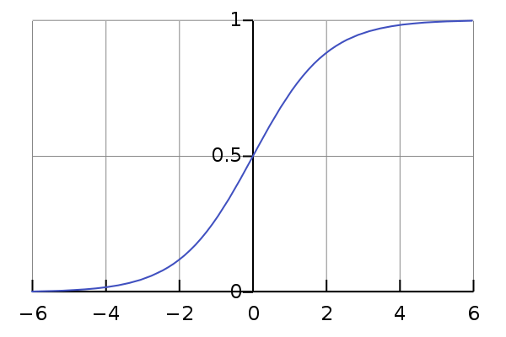





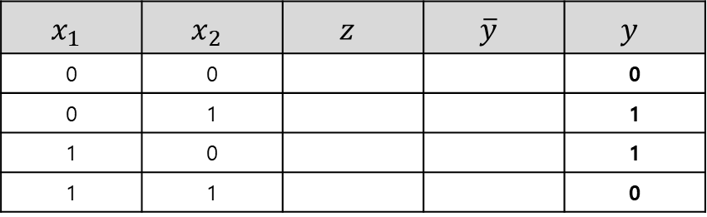








XOR Problem
$$σ\left(z\right)$$
Example for Intuition: single perceptron
$$x_{2}$$
$$1$$
$$ω_{10}$$
$$ω_{11}$$
$$x_{1}$$
$$a$$
$$\overline{y}$$
$$x_{2}$$
$$ω_{12}$$
$$x_{1}$$
$y=x_{1} XOR x_{2} where x_{1}, x_{2}∈\left\{0,1\right\}$
$\overline{y}=a=σ\left(z\right)=σ\left(ω_{10}+ω_{11}x_{1}+ω_{12}x_{2}\right)$
$$x_{1}$$ | $$x_{2}$$ | $$y$$
0 | 0 | 0
0 | 1 | 1
1 | 0 | 1
1 | 1 | 0
$$x_{1}$$ | $$x_{2}$$ | $$z$$ | $$\overline{y}$$ | $$y$$
0 | 0 |  |  | 0
0 | 1 |  |  | 1
1 | 0 |  |  | 1
1 | 1 |  |  | 0

Slide 13
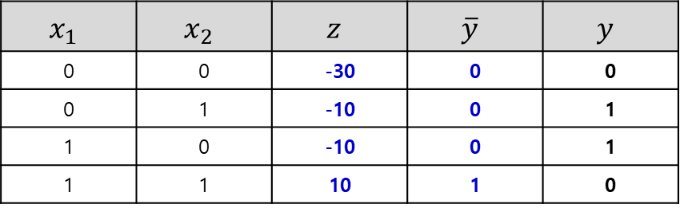

XOR Problem (cont’d)
$$σ\left(z\right)$$
Example for Intuition: single perceptron
$$x_{2}$$
$$1$$
$$ω_{10}$$
$$ω_{11}$$
$$x_{1}$$
$$a$$
$$\overline{y}$$
$$x_{2}$$
$$ω_{12}$$
$ω=\left[−30, 20, 20\right]$
$$x_{1}$$
$y=x_{1} XOR x_{2} where x_{1}, x_{2}∈\left\{0,1\right\}$
$\overline{y}=a=σ\left(z\right)=σ\left(ω_{10}+ω_{11}x_{1}+ω_{12}x_{2}\right)$
$$x_{1}$$ | $$x_{2}$$ | $$y$$
0 | 0 | 0
0 | 1 | 1
1 | 0 | 1
1 | 1 | 0
$$x_{1}$$ | $$x_{2}$$ | $$z$$ | $$\overline{y}$$ | $$y$$
0 | 0 | -30 | 0 | 0
0 | 1 | -10 | 0 | 1
1 | 0 | -10 | 0 | 1
1 | 1 | 10 | 1 | 0

Slide 14
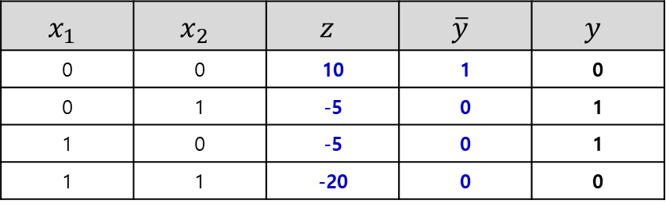

XOR Problem (cont’d)
$$σ\left(z\right)$$
Example for Intuition: single perceptron
$$x_{2}$$
$$1$$
$$ω_{10}$$
$$ω_{11}$$
$$x_{1}$$
$$a$$
$$\overline{y}$$
$$x_{2}$$
$$ω_{12}$$
$ω=\left[10, −15, −15\right]$
$$x_{1}$$
$y=x_{1} XOR x_{2} where x_{1}, x_{2}∈\left\{0,1\right\}$
$\overline{y}=a=σ\left(z\right)=σ\left(ω_{10}+ω_{11}x_{1}+ω_{12}x_{2}\right)$
$$x_{1}$$ | $$x_{2}$$ | $$y$$
0 | 0 | 0
0 | 1 | 1
1 | 0 | 1
1 | 1 | 0
$$x_{1}$$ | $$x_{2}$$ | $$z$$ | $$\overline{y}$$ | $$y$$
0 | 0 | 10 | 1 | 0
0 | 1 | -5 | 0 | 1
1 | 0 | -5 | 0 | 1
1 | 1 | -20 | 0 | 0

Slide 15
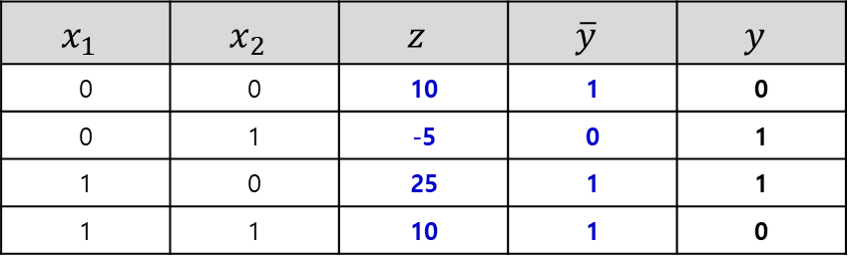

XOR Problem (cont’d)
$$σ\left(z\right)$$
Example for Intuition: single perceptron
$$x_{2}$$
$$1$$
$$ω_{10}$$
$$ω_{11}$$
$$x_{1}$$
$$a$$
$$\overline{y}$$
$$x_{2}$$
$$ω_{12}$$
$ω=\left[10, 15, −15\right]$
$$x_{1}$$
$y=x_{1} XOR x_{2} where x_{1}, x_{2}∈\left\{0,1\right\}$
$\overline{y}=a=σ\left(z\right)=σ\left(ω_{10}+ω_{11}x_{1}+ω_{12}x_{2}\right)$
$$x_{1}$$ | $$x_{2}$$ | $$y$$
0 | 0 | 0
0 | 1 | 1
1 | 0 | 1
1 | 1 | 0
$$x_{1}$$ | $$x_{2}$$ | $$z$$ | $$\overline{y}$$ | $$y$$
0 | 0 | 10 | 1 | 0
0 | 1 | -5 | 0 | 1
1 | 0 | 25 | 1 | 1
1 | 1 | 10 | 1 | 0

Slide 16
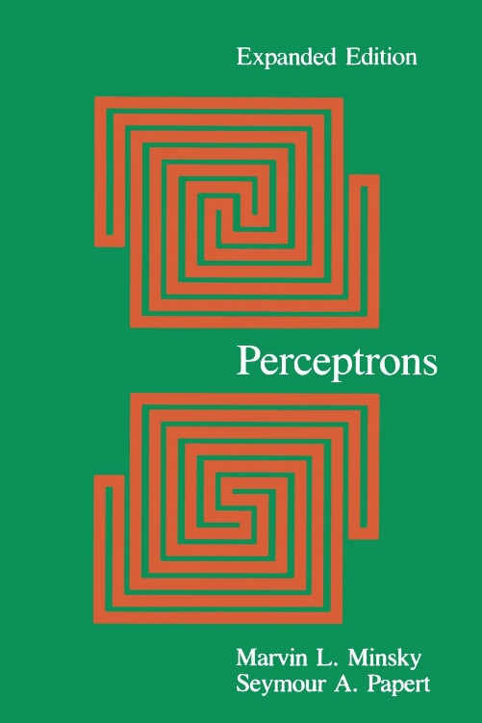
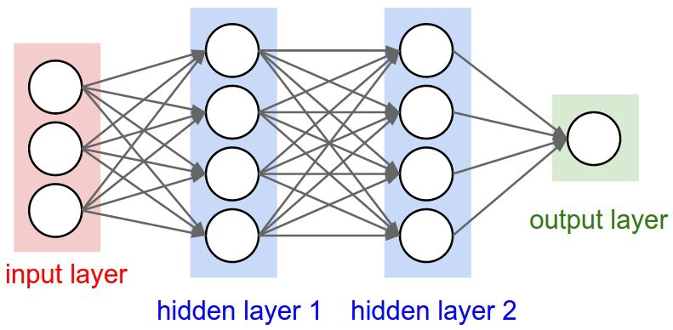
Multi-Layer Perceptron
Multi-layer perceptron for XOR problem
Marvin Minsky, MIT AI Lab, Perceptrons (1969)
Notes:
Minsky 교수, Single perceptron으로는 non-linear 문제를 풀 수 없다는 것을 증명

Slide 17





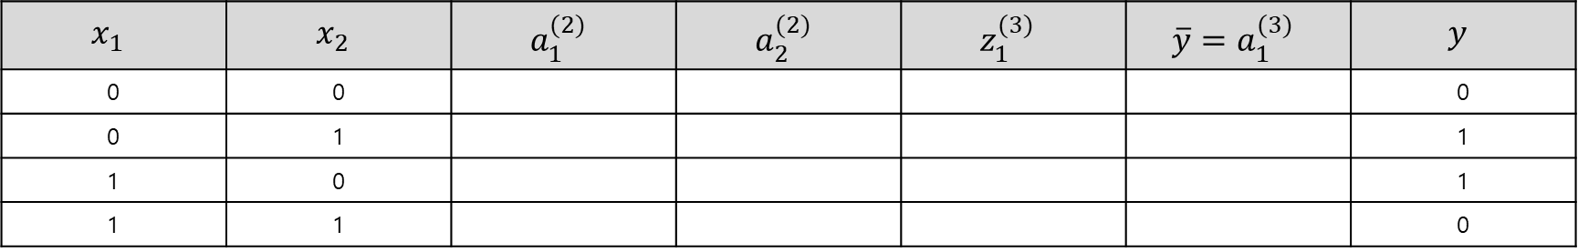


Multi-Layer Perceptron (cont’d)
Example for Intuition: multi-layer perceptron
$$1$$
$$a_{1}^{(2)}$$
$$x_{1}$$
$$a_{1}^{(3)}$$
$$\overline{y}$$
$$a_{2}^{(2)}$$
$$x_{2}$$
$\overline{y}=a_{1}^{(3)}=σ\left(z_{1}^{(3)}\right)=σ\left(ω_{10}^{(2)}+ω_{11}^{(2)}a_{1}^{(2)}+ω_{12}^{(2)}a_{2}^{(2)}\right)$
$$x_{1}$$ | $$x_{2}$$ | $$a_{1}^{(2)}$$ | $$a_{2}^{(2)}$$ | $$z_{1}^{(3)}$$ | $$\overline{y}=a_{1}^{(3)}$$ | $$y$$
0 | 0 |  |  |  |  | 0
0 | 1 |  |  |  |  | 1
1 | 0 |  |  |  |  | 1
1 | 1 |  |  |  |  | 0

Slide 18





Multi-Layer Perceptron (cont’d)
Example for Intuition: multi-layer perceptron
$$1$$
$ω_{1i}^{(1)}=\left[−30, 20, 20\right]$
$$a_{1}^{(2)}$$
$$ω_{11}^{(2)}$$
$$x_{1}$$
$$a_{1}^{(3)}$$
$$\overline{y}$$
$ω_{2i}^{(1)}=\left[10, −15, −15\right]$
$$a_{2}^{(2)}$$
$$ω_{12}^{(2)}$$
$ω_{1i}^{(2)}=\left[6, −11, −11\right]$
$$x_{2}$$
$\overline{y}=a_{1}^{(3)}=σ\left(z_{1}^{(3)}\right)=σ\left(ω_{10}^{(2)}+ω_{11}^{(2)}a_{1}^{(2)}+ω_{12}^{(2)}a_{2}^{(2)}\right)$
$$x_{1}$$ | $$x_{2}$$ | $$a_{1}^{(2)}$$ | $$a_{2}^{(2)}$$ | $$z_{1}^{(3)}$$ | $$\overline{y}=a_{1}^{(3)}$$ | $$y$$
0 | 0 |  |  |  |  | 0
0 | 1 |  |  |  |  | 1
1 | 0 |  |  |  |  | 1
1 | 1 |  |  |  |  | 0
0
0
0
1
1
0
0
0
-5
6
6
-5
0
1
1
0

Slide 19




Multi-Layer Perceptron (cont’d)
Example for Intuition: multi-layer perceptron
$$1$$
$$x_{2}$$
$$a_{2}$$
$$a_{1}^{(2)}$$
$$ω_{11}^{(2)}$$
$$x_{1}$$
$$a_{1}^{(3)}$$
$$\overline{y}$$
$$a_{2}^{(2)}$$
$$ω_{12}^{(2)}$$
$$x_{2}$$
$$x_{1}$$
$$a_{1}$$
Trained new features
Non-linear
Linear
$\overline{y}=a_{1}^{(3)}=σ\left(z_{1}^{(3)}\right)=σ\left(ω_{10}^{(2)}+ω_{11}^{(2)}a_{1}^{(2)}+ω_{12}^{(2)}a_{2}^{(2)}\right)$
$$x_{1}$$ | $$x_{2}$$ | $$a_{1}^{(2)}$$ | $$a_{2}^{(2)}$$ | $$z_{1}^{(3)}$$ | $$\overline{y}=a_{1}^{(3)}$$ | $$y$$
0 | 0 |  |  |  |  | 0
0 | 1 |  |  |  |  | 1
1 | 0 |  |  |  |  | 1
1 | 1 |  |  |  |  | 0
0
0
0
1
1
0
0
0
-5
6
6
-5
0
1
1
0
Notes:
학습을 통해 given data 새로운 feature a1,a2를 도출
원래 주어진 feature 보다 결과를 더 잘 설명할 수 있는 feature를 학습
예) 집의 가로 길이, 세로 길이를 입력 -> 다음 단계에서 넓이 형태에 해당하는 특징 값을 도출

Slide 20





























Multi-Layer Perceptron (cont’d)
Neural network: connecting neurons in deep and wide
* $s\left(j\right)$: # of unit in $j$-th layer
$$ω_{11}^{(1)}$$
$$a_{1}^{(2)}$$
$$a_{1}^{(3)}$$
$$⋯$$
$$a_{1}^{(l)}$$
$$ω_{11}^{(l)}$$
$$x_{1}$$
$${\overline{y}}_{1}$$
$$a_{2}^{(2)}$$
$$a_{2}^{(3)}$$
$$⋯$$
$$a_{2}^{(l)}$$
$$x_{2}$$
$${\overline{y}}_{2}$$
$$⋮$$
$$⋮$$
$$⋮$$
$$⋮$$
$$⋮$$
$$⋮$$
$$x_{s(in)}$$
$${\overline{y}}_{s(out)}$$
$$ω_{s\left(2\right)s(in)}^{(1)}$$
$$a_{s(2)}^{(2)}$$
$$a_{s(3)}^{(3)}$$
$$⋯$$
$$a_{s(l)}^{(l)}$$
$$ω_{s\left(out\right)s(l)}^{(l)}$$
Input layer
Hidden layer
Output layer
(hypothesis)
Notes:
우리가 알고 있는 형태의 neural network
Notation 설명
Input layer: x
Hidden layer: weight, activation value
Output layer: y
Layer의 개수: input을 제외, l+1 layers
Subscript: node index
Superscript: layer index

Slide 21
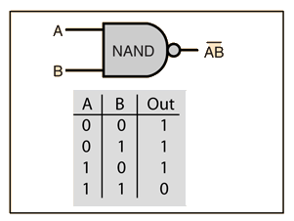
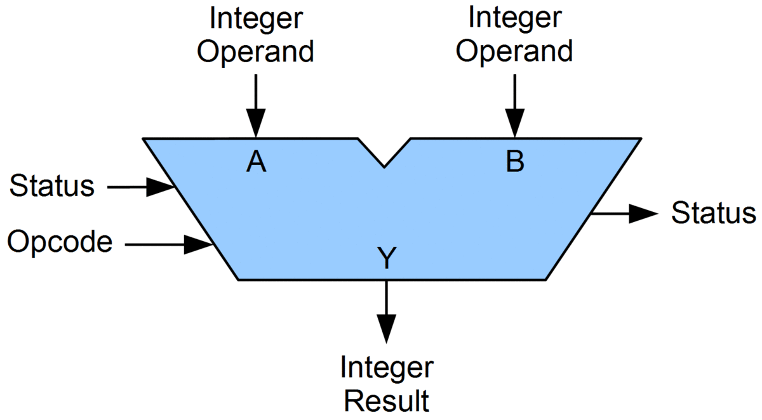

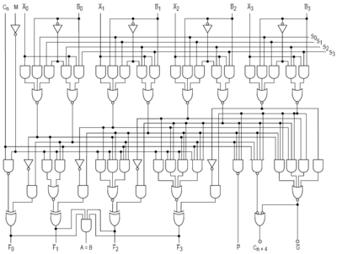
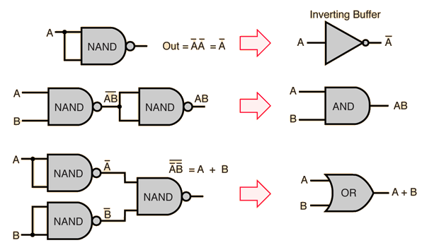
Multi-Layer Perceptron (cont’d)
From logic gate to computer
NAND logic Gate
ALU; arithmetic logic unit
CPU; central processing unit

Slide 22























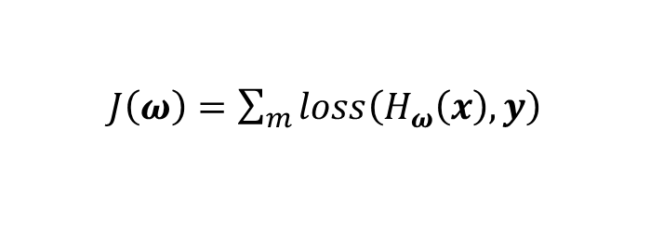
How to Train the Neural Net?
Learning
학습: 주어진 dataset을 이용해 weight 𝝎의 최적 값을 자동으로 획득
Cost function 𝐽(𝝎)를 정의하고, 이를 최적화하는 방향으로 weight 𝝎 를 조정 예) Gradient descent algorithm
How to calculate the gradient of a neural network?
$$ω_{11}^{(1)}$$
$$a_{1}^{(2)}$$
$$a_{1}^{(3)}$$
$$⋯$$
$$a_{1}^{(l)}$$
$$ω_{11}^{(l)}$$
$J\left(ω\right)=\sum_{m}{loss\left(H_{ω}\left(x\right),y\right)}$
$$x_{1}$$
$${\overline{y}}_{1}$$
$$a_{2}^{(2)}$$
$$a_{2}^{(3)}$$
$$⋯$$
$$a_{2}^{(l)}$$
$$x_{2}$$
$$H_{ω}\left(x\right)$$
$${\overline{y}}_{2}$$
$\frac{∂}{∂ω_{ij}}J\left(ω\right)$ → $\frac{∂}{∂ω_{ij}}H_{ω}\left(x\right)$
$$⋮$$
$$⋮$$
$$⋮$$
$$⋮$$
$$⋮$$
$$⋮$$
Analytical solution → Too complex
Numerical solution → Too heavy
$$x_{s(in)}$$
$${\overline{y}}_{s(out)}$$
$$ω_{s\left(2\right)s(in)}^{(1)}$$
$$a_{s(2)}^{(2)}$$
$$a_{s(3)}^{(3)}$$
$$⋯$$
$$a_{s(l)}^{(l)}$$
$$ω_{s\left(out\right)s(l)}^{(l)}$$
Notes:
No closed form solution: 해가 없는 경우

Slide 23
Multi-Layer Perceptron (cont’d)
Multi-layer perceptron for XOR problem
We need to use MLP, multilayer perceptrons (multilayer neural networks)
No one on earth had found a viable way to train MLPs good enough to learn such simple functions.
Marvin Minsky, MIT AI Lab, Perceptrons (1969)
Notes:
Minsky 교수, Single perceptron으로는 non-linear 문제를 풀 수 없다는 것을 증명

Slide 24

1st AI Winter (1969 - 1986)
Brace Yourself,
Winter is Coming

Slide 25
Back Propagation

Slide 26
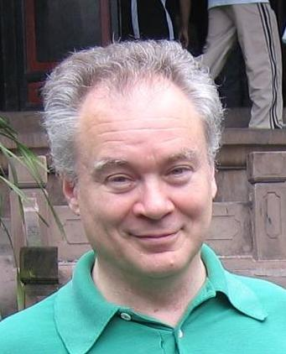
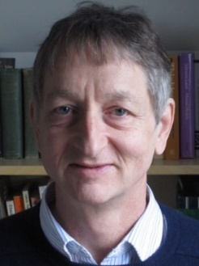
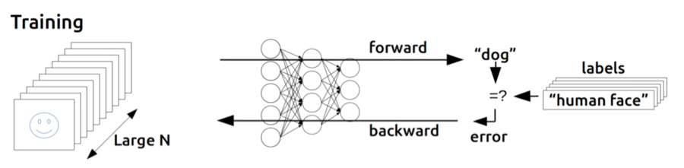
Backpropagation
The way to train MLPs to learn
Weight initialization
Forward - Compute/update an activation value of each node
Backward - Compute gradient of each weight using a partial derivative - Update the weights using gradient descent algorithm
Repeat 2 and 3 until converge
Paul Werbos
(1974, 1982)
Geoffrey Hinton
(1986)
Notes:
Weight/parameter의 기울기를 효율적으로 계산하는 방법

Slide 27


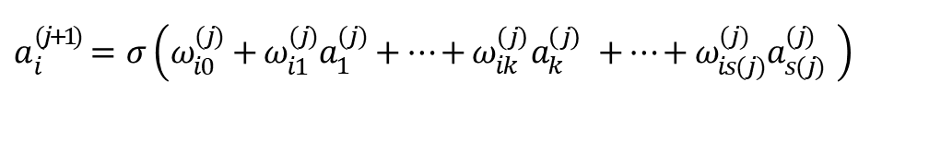











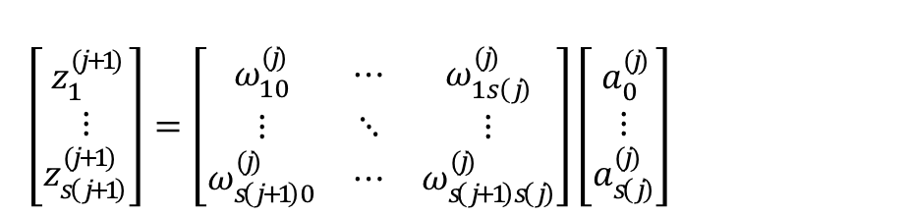




Forward Propagation
Prediction: Feed forward propagation
주어진 input과 weight를 이용해 output을 계산하는 과정
Matrix multiplication을 통해 간단하게 표현이 가능
$$a_{1}^{(j)}$$
$$a_{1}^{(j+1)}$$
‘Activation’ of $i$-th unit in $(j+1)$-th layer
$$ω_{i1}^{(j)}$$
$a_{i}^{(j+1)}=σ\left(ω_{i0}^{(j)}+ω_{i1}^{(j)}a_{1}^{(j)}+…+ω_{ik}^{\left(j\right)}a_{k}^{\left(j\right)} +…+ω_{is(j)}^{(j)}a_{s(j)}^{(j)} \right)$
$$⋮$$
$$⋮$$
$$z_{i}^{(j+1)}$$
$$ω_{ik}^{(j)}$$
Matrix representation of computing $(j+1)$-th layer
$$⋯$$
$$a_{k}^{(j)}$$
$$a_{i}^{(j+1)}$$
$$⋯$$
$a^{(j+1)} =σ\left(z^{(j+1)}\right)$
$\left[\begin{matrix}z_{1}^{(j+1)} \\ ⋮ \\ z_{s\left(j+1\right)}^{(j+1)}\end{matrix}\right]=\left[\begin{matrix}ω_{10}^{(j)} & ⋯ & ω_{1s\left(j\right)}^{(j)} \\ ⋮ & ⋱ & ⋮ \\ ω_{s\left(j+1\right)0}^{(j)} & ⋯ & ω_{s\left(j+1\right)s\left(j\right)}^{(j)}\end{matrix}\right]\left[\begin{matrix}a_{0}^{(j)} \\ ⋮ \\ a_{s\left(j\right)}^{(j)}\end{matrix}\right]$
$$⋮$$
$$⋮$$
$$ω_{is(j)}^{(j)}$$
$$a_{s(j)}^{(j)}$$
$$a_{s(j+1)}^{(j+1)}$$
$$ω^{(j)} [s(j+1)×s(j)+1]$$

Slide 28


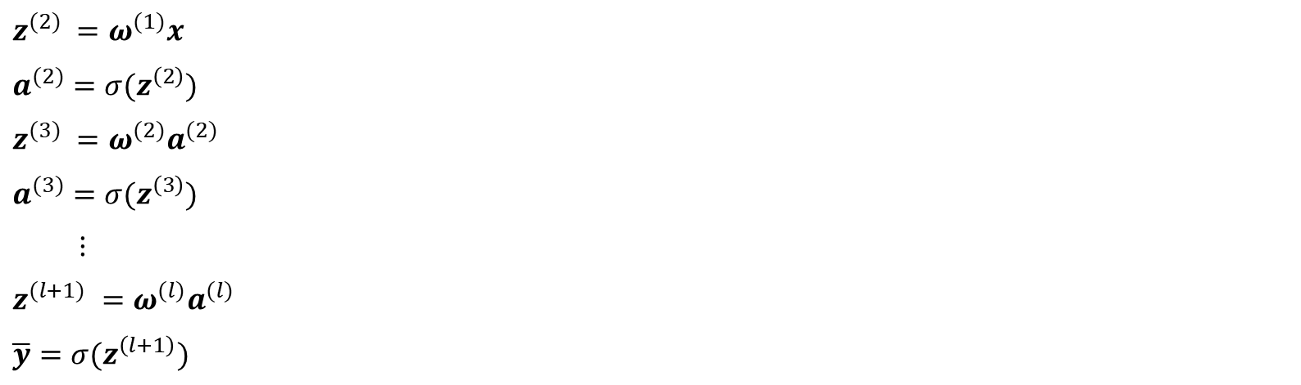


Forward Propagation (cont’d)
Prediction: Feed forward propagation
Forward Propagation (Prediction)
$$ω_{11}^{(1)}$$
$$a_{1}^{(2)}$$
$$a_{1}^{(3)}$$
$$⋯$$
$$a_{1}^{(l)}$$
$$ω_{11}^{(l)}$$
$$x_{1}$$
$${\overline{y}}_{1}$$
$z^{(2)} =ω^{(1)}x$
$a^{(2)}=σ(z^{\left(2\right)})$
$z^{(3)} =ω^{(2)}a^{(2)}$
$a^{(3)}=σ(z^{\left(3\right)})$
$⋮$
$z^{(l+1)} =ω^{(l)}a^{(l)}$
$\overline{y}=σ(z^{\left(l+1\right)})$
$$a_{2}^{(2)}$$
$$a_{2}^{(3)}$$
$$⋯$$
$$a_{2}^{(l)}$$
$$x_{2}$$
$${\overline{y}}_{2}$$
$$⋮$$
$$⋮$$
$$⋮$$
$$⋮$$
$$⋮$$
$$⋮$$
$$x_{s(in)}$$
$${\overline{y}}_{s(out)}$$
$$ω_{s\left(2\right)s(in)}^{(1)}$$
$$a_{s(2)}^{(2)}$$
$$a_{s(3)}^{(3)}$$
$$⋯$$
$$a_{s(l)}^{(l)}$$
$$ω_{s\left(out\right)s(l)}^{(l)}$$

Slide 29

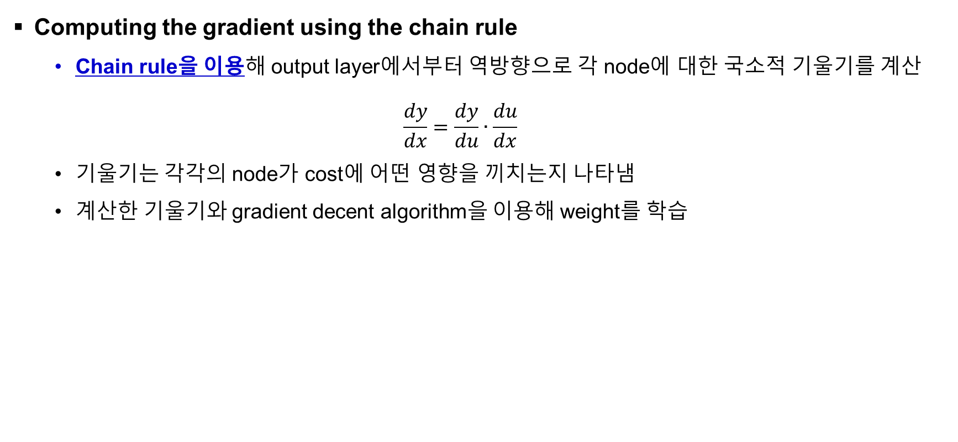
Backward Propagation
Computing the gradient using the chain rule
Chain rule을 이용해 output layer에서부터 역방향으로 각 node에 대한 국소적 기울기를 계산
$$\frac{dy}{dx}=\frac{dy}{du}∙\frac{du}{dx}$$
기울기는 각각의 node가 cost에 어떤 영향을 끼치는지 나타냄
계산한 기울기와 gradient decent algorithm을 이용해 weight를 학습

Slide 30


























Backward Propagation (cont’d)
Example for intuition I: Weighted summation
$$−2$$
$$x_{1}$$
$$g_{1}=ω_{1}x_{1}$$
$$×$$
$$=−10$$
$$1$$
$$b$$
$$5$$
$$ω_{1}$$
$$ω_{1}$$
$$+$$
$$x_{1}$$
$$z$$
$$4$$
$$x_{2}$$
$$z=g_{1}+g_{2}+b$$
$$=1$$
$$ω_{2}$$
$$×$$
$$g_{2}=ω_{2}x_{2}$$
$$x_{2}$$
$$2$$
$$ω_{2}$$
$$=8$$
$$3$$
$$b$$
Forward →

Slide 31

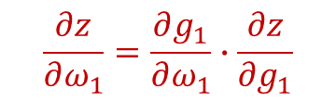




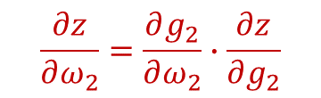
Backward Propagation (cont’d)
Example for intuition I: Weighted summation
$$\frac{∂z}{∂g_{1}}=1$$
$$−2$$
$$x_{1}$$
$$\frac{∂z}{∂ω_{1}}=\frac{∂g_{1}}{∂ω_{1}}∙\frac{∂z}{∂g_{1}}$$
$$g_{1}=ω_{1}x_{1}$$
$$×$$
$$=−10$$
$$1$$
$$b$$
$$5$$
$$ω_{1}$$
$$=x_{1}∙1=−2$$
$$ω_{1}$$
$$\frac{∂z}{∂g_{2}}=1$$
$$+$$
$$x_{1}$$
$$z$$
$$4$$
$$x_{2}$$
$$z=g_{1}+g_{2}+b$$
$$\frac{∂z}{∂ω_{2}}=\frac{∂g_{2}}{∂ω_{2}}∙\frac{∂z}{∂g_{2}}$$
$$=1$$
$$ω_{2}$$
$$×$$
$$g_{2}=ω_{2}x_{2}$$
$$x_{2}$$
$$2$$
$$ω_{2}$$
$$=8$$
$$\frac{∂z}{∂b}=1$$
$$=x_{2}∙1=4$$
$$3$$
$$b$$
← Backward

Slide 32














Backward Propagation (cont’d)
Example for intuition II: Sigmoid function
$$σ$$
$$σ\left(z\right)=\frac{1}{1+e^{−z}}$$
$$f=−z$$
$$g=e^{f}$$
$$h=1+g$$
$$a=1 / h$$
$$z$$
$$×$$
$$exp$$
$$+$$
$$/$$
$$a$$
$$−1$$
$$1$$
Forward →

Slide 33

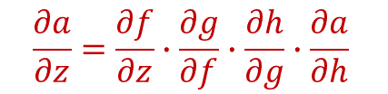






Backward Propagation (cont’d)
Example for intuition II: Sigmoid function
$$\frac{∂a}{∂z}=\frac{∂f}{∂z}∙\frac{∂g}{∂f}∙\frac{∂h}{∂g}∙\frac{∂a}{∂h}$$
$$σ$$
$$=−1∙e^{f}∙1∙−\frac{1}{h^{2}}$$
$$σ\left(z\right)=\frac{1}{1+e^{−z}}$$
$$=e^{f}∙\frac{1}{h^{2}}$$
$$f=−z$$
$$h=1+g$$
$$=\frac{e^{−z}}{{\left(1+e^{−z}\right)}^{2} }$$
$$g=e^{f}$$
$$a=1 / h$$
$$z$$
$$×$$
$$exp$$
$$+$$
$$/$$
$$a$$
$$\frac{∂f}{∂z}=−1$$
$$\frac{∂g}{∂f}=e^{f}$$
$$\frac{∂h}{∂g}=1$$
$$\frac{∂a}{∂h}=−\frac{1}{h^{2}}$$
$$−1$$
$$1$$
← Backward

Slide 34











Backward Propagation (cont’d)
Prediction: Feed forward propagation
$$ω_{11}^{(1)}$$
$$a_{1}^{(2)}$$
$$a_{1}^{(3)}$$
$$⋯$$
$$a_{1}^{(l)}$$
$$ω_{11}^{(l)}$$
$$ω_{21}^{(1)}$$
$$ω_{12}^{(l)}$$
$$x_{1}$$
$${\overline{y}}_{1}$$
$$x_{1}$$
$$ω_{22}^{(2)}$$
$$ω_{2i}^{(l−1)}$$
$${\overline{y}}_{1}$$
$$L\left({\overline{y}}_{1},y_{1}\right)$$
$$a_{2}^{(2)}$$
$$a_{2}^{(3)}$$
$$a_{2}^{(l)}$$
$$a_{2}^{(2)}$$
$$a_{2}^{(3)}$$
$$⋯$$
$$a_{2}^{(l)}$$
$$⋯$$
$$\frac{∂L}{∂ω_{12}^{(l)}}$$
$$\frac{∂ω_{22}^{(2)}}{∂ω_{21}^{(1)}}$$
$$x_{2}$$
$$\frac{∂ω_{12}^{(l)}}{∂ω_{2i}^{(l−1)}}$$
$${\overline{y}}_{2}$$
$$⋮$$
$$⋮$$
$$⋮$$
$$⋮$$
$$⋮$$
$$⋮$$
Backward Propagation (Derivative)
$$x_{s(in)}$$
$${\overline{y}}_{s(out)}$$
$$ω_{s\left(2\right)s(in)}^{(1)}$$
$$a_{s(2)}^{(2)}$$
$$a_{s(3)}^{(3)}$$
$$⋯$$
$$a_{s(l)}^{(l)}$$
$$ω_{s\left(out\right)s(l)}^{(l)}$$

Slide 35
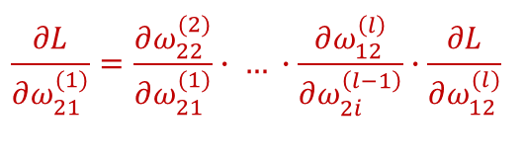
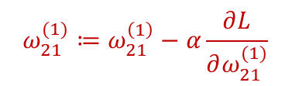
Backward Propagation (cont’d)
Prediction: Feed forward propagation
$$ω_{11}^{(1)}$$
$$a_{1}^{(2)}$$
$$a_{1}^{(3)}$$
$$⋯$$
$$a_{1}^{(l)}$$
$$ω_{11}^{(l)}$$
$$ω_{21}^{(1)}$$
$$ω_{12}^{(l)}$$
$$x_{1}$$
$${\overline{y}}_{1}$$
$$x_{1}$$
$$ω_{22}^{(2)}$$
$$ω_{2i}^{(l−1)}$$
$${\overline{y}}_{1}$$
$$L\left({\overline{y}}_{1},y_{1}\right)$$
$$a_{2}^{(2)}$$
$$a_{2}^{(3)}$$
$$a_{2}^{(l)}$$
$$a_{2}^{(2)}$$
$$a_{2}^{(3)}$$
$$⋯$$
$$a_{2}^{(l)}$$
$$⋯$$
$$\frac{∂L}{∂ω_{12}^{(l)}}$$
$$\frac{∂ω_{22}^{(2)}}{∂ω_{21}^{(1)}}$$
$$x_{2}$$
$$\frac{∂ω_{12}^{(l)}}{∂ω_{2i}^{(l−1)}}$$
$${\overline{y}}_{2}$$
$$⋮$$
$$⋮$$
$$⋮$$
$$⋮$$
$$⋮$$
$$⋮$$
Update weights
$$\frac{∂L}{∂ω_{21}^{(1)}}=\frac{∂ω_{22}^{(2)}}{∂ω_{21}^{(1)}}∙ … ∙\frac{∂ω_{12}^{\left(l\right)}}{∂ω_{2i}^{\left(l−1\right)}}∙\frac{∂L}{∂ω_{12}^{(l)}}$$
$$x_{s(in)}$$
$${\overline{y}}_{s(out)}$$
$$ω_{s\left(2\right)s(in)}^{(1)}$$
$$a_{s(2)}^{(2)}$$
$$a_{s(3)}^{(3)}$$
$$⋯$$
$$a_{s(l)}^{(l)}$$
$$ω_{s\left(out\right)s(l)}^{(l)}$$
$$ω_{21}^{(1)}≔ω_{21}^{\left(1\right)}−α\frac{∂L}{∂ω_{21}^{(1)}}$$

Slide 36


2nd AI Winter (1986 - 2006)
Vanishing gradient problem
Backpropagation just did not work well for normal neural nets with many layers
Backpropagation for deep NN

Slide 37

Practice (HW #2)
Programming Exercises
Multi-class logistic regression - 다중 클래스 로지스틱 회귀 예제 실습 (p.112 ~ 123) - Either TensorFlow or Keras
Multi-layer Perceptron - 다층 퍼셉트론 예제 실습 (p.123 ~ 136) - Either TensorFlow or Keras
Fig. Experimental result of the Softmax classification
https://github.com/wikibook/deep-learning-with-tensorflow

Slide 38
Summary
Artificial Neural Network
Perceptron; artificial Neuron
Multi-layer perceptron
Backward propagation
[Next class] Deep learning
Activation function (tanh, ReLU, leaky ReLU, …)
Dropout
Batch normalization (SGD, Momentum, Adam, …)
Robust optimizer

Slide 39

Assignment #3
Programming Exercises (Due date: 01/31)
MNIST Classification - MNIST dataset 학습을 위한 ANN 구현 (p.146 ~ 151) - 딥러닝 기법 I: activation function & dropout (p.157 ~ 173) - Either TensorFlow or Keras * (Optional) Customized DNN class and visualization (p. 173 ~194)
Fig. MNIST dataset

Slide 40


Acknowledgment
모두를 위한 머신러닝/딥러닝 강의
Dr. Sung Kim, HKUST, Hongkong (http://hunkim.github.io/ml/)
Machine Learning & Deep Learning 강의
Dr. Andrew Ng, Stanford University (http://www.andrewng.org/)
참고문헌
스고모리 유우스케, “정석으로 배우는 딥러닝“, 위키북스
W. Saito Goki, “Deep learning from scratch”, O’REILLY
그 밖에…(강의노트, 블로그, 페이스북 등)

Slide 41


Andrew Ng
@AndrewYNg
“AI is a superpower.”
Thank you.
Yong Yi Lee, GDG Organizer (yylee.st.john@gmail.com)

Slide 42
Template

Slide 43
Main Title
Author
Date

Slide 44
Section

Slide 45
Title (Arial Black, 44, Bold)
Subtitle (Arial, 20)
Content (Arial, 18) - Sub Content (Arial, 16) - Sub Content (Arial, 16)
Content (Arial, 18) - Sub Content (Arial, 16) - Sub Content (Arial, 16)

Slide 46
Title (Arial Black, 44, Bold)
Subtitle (Arial, 20)
Content (Arial, 18) - Sub Content (Arial, 16)
Figure / Video
Fig. or Video Caption (Arial, 14)
Table Caption (Arial, 14)

